Slide 1
Comparing CNN Architectures
Week 7 - Day 2

Slide 2
Why Deeper Networks?
Deeper CNNs extract more abstract features
Early layers: edges, textures
Deeper layers: shapes, object parts, concepts
But: Deeper ≠ always better
Can cause vanishing gradients
Harder to train

Slide 3
VGGNet – Simplicity with Depth
Introduced in 2014 (VGG16, VGG19)
Uses only 3x3 convolutions and 2x2 max-pooling
Deep architecture with simplicity & uniformity
Architecture (VGG16):
13 conv layers + 3 fully connected layers

Slide 4
Problem – Vanishing Gradients
In very deep nets:
Gradients shrink during backpropagation
Lower layers learn slowly or not at all
Symptoms:
Training accuracy stuck
Loss not decreasing
Model not converging

Slide 5
ResNet – Residual Networks
Introduced in 2015 by Microsoft
Skip connections bypass certain layers
Helps gradient flow easily → train much deeper networks

Slide 6
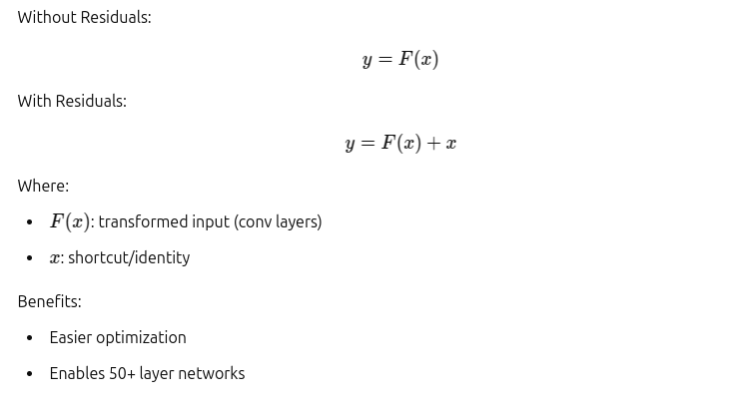
How Residual Blocks Work

Slide 7
DenseNet – Even More Connection
Introduced in 2017
Each layer gets inputs from all previous layers
Promotes feature reuse
Smaller models, better performance

Slide 8
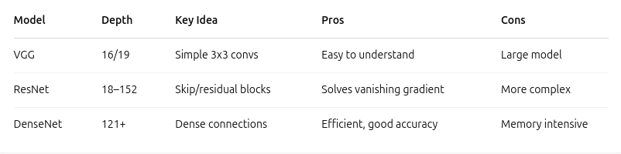
Comparing Architectures

Slide 9

Transfer Learning
Freeze pretrained feature extractor layers
Replace classifier head with custom layers
Fine-tune last few layers for better performance

Slide 10
Activity
Activity Goal:
Train a pretrained ResNet/VGG
Dataset: CIFAR-10 or MNIST
Evaluate:
Training time
Accuracy
Overfitting
Generalization

